Slide 1

Restaurant Management System
Group 9
Harini Kamarthy
Vaishnavi Gunna
Sai Sneha Palle
Sharan Kumar Pallapu
Greeshma Sangaraju
Sahit Reddy Chinthakuntla

Slide 2
Contents
Project Description
ER Model
Software Platforms & Tools
Installation & Execution
Application Main Screens
Demo

Slide 3
Project Description
Restaurant Management System is a desktop software application designed that helps restaurant owners manage their business operations by automating various tasks such as order management, handling payments, scheduling reservations, storing customer feedbacks, employee management.
System is designed to give best customer experience while streamlining restaurant operations. Application user can make reservations of tables in a restaurant, Order the food items, make payments, provide the feedback. Employee Management system will now provide only the view of Restaurant and Customer related data.

Slide 4
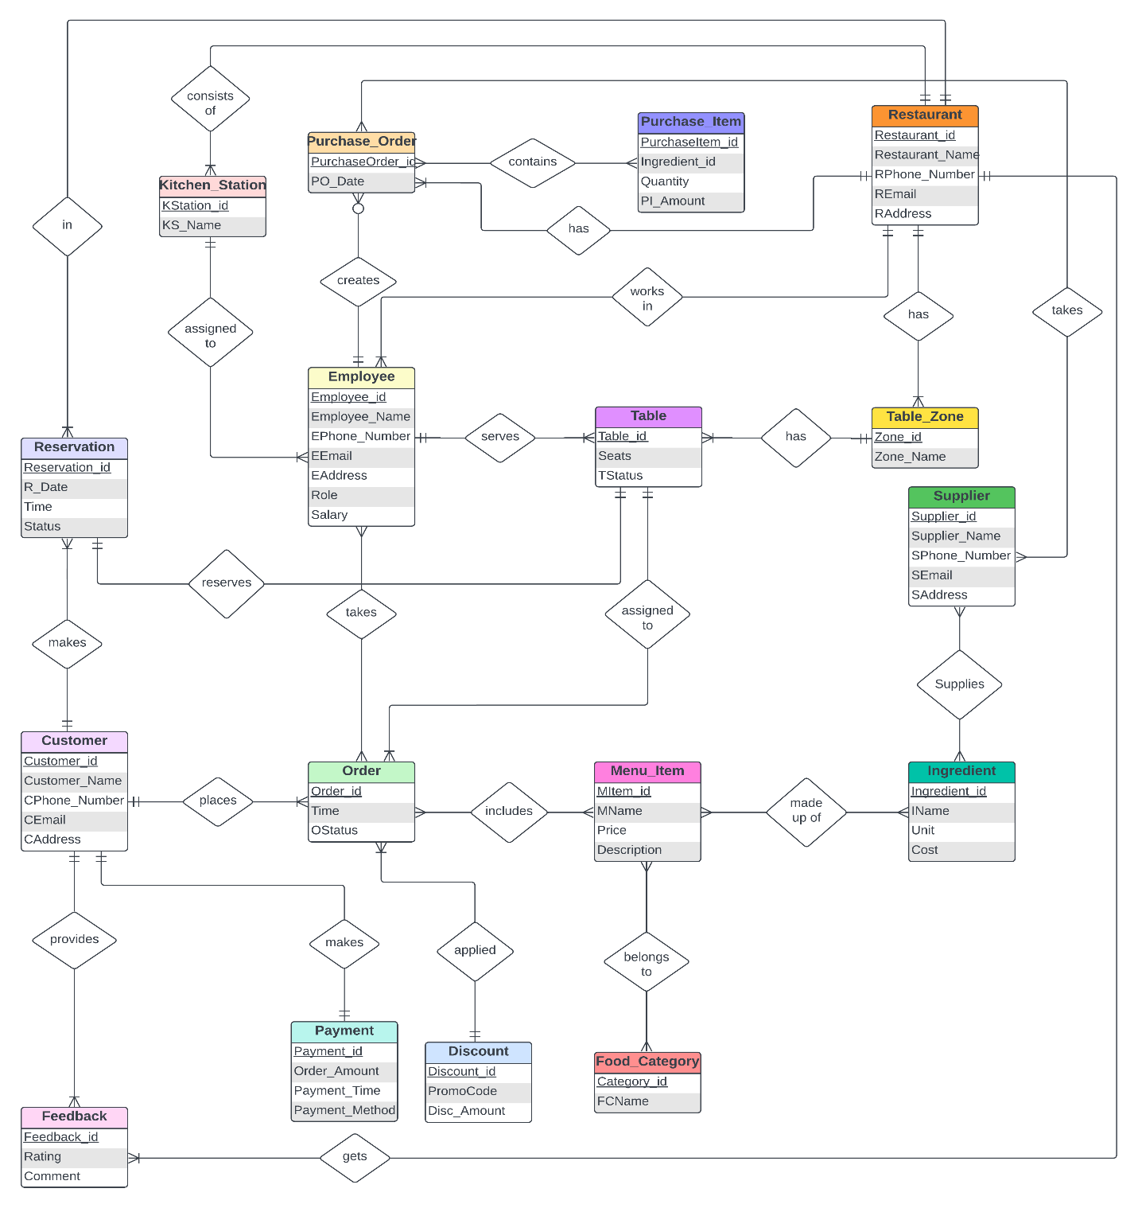
ER Model

Slide 5

Software Platforms & Tools
Programming Languages
Python
SQL
Platforms/Tools
My SQL WorkBench
Microsoft Visual Studio / Jupyter NoteBook / Anaconda
CustomTkinter GUI

Slide 6
Installation & Execution
Pre-requisites:
Install MySQL Workbench, Python Libraries, Jupyter Notebook, CustomTkinter Packages
Setup to run the project:
Unzip the file ‘Restaurant Project – Harini Kamarthy.zip’
Database files are exported to ‘Restaurant Project – Harini Kamarthy/Database’ folder
Create a database in MySQL Workbench and import these Database files into it
Steps to execute the project/application:
Open command prompt & Navigate to “Restaurant Project – Harini Kamarthy/UI Code” folder.
Give command “jupyter notebook”.
From the opened weblink, open file “Restaurant Project UI” file.
Tap on the code cell & click on “Run” button.

Slide 7
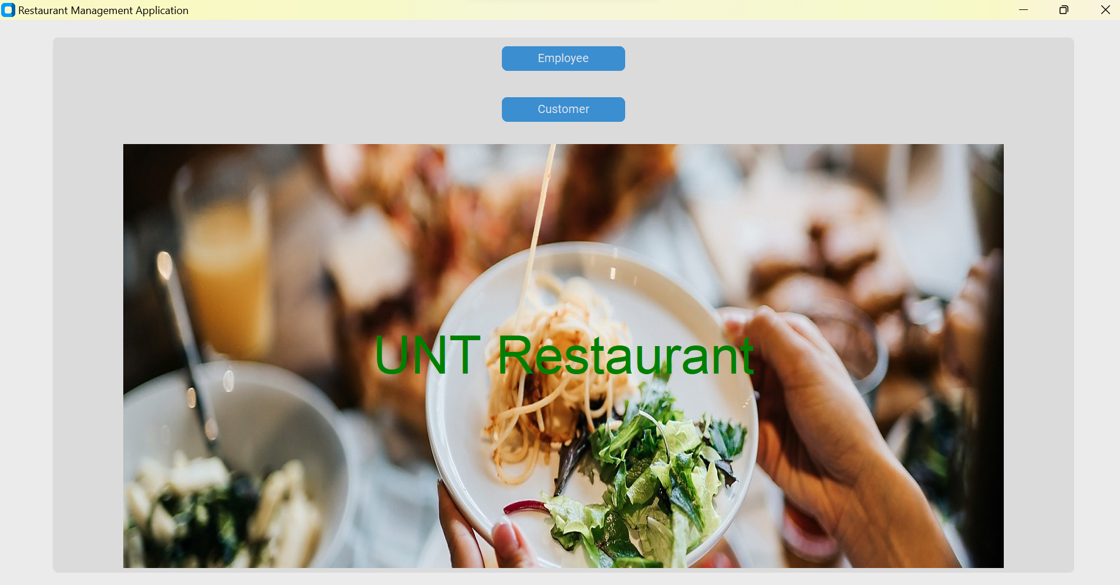
Application Main Screens
Application have two main flows, Customer flow & Employee flow. So, on Home Screen we have 2 buttons for the same.

Slide 8
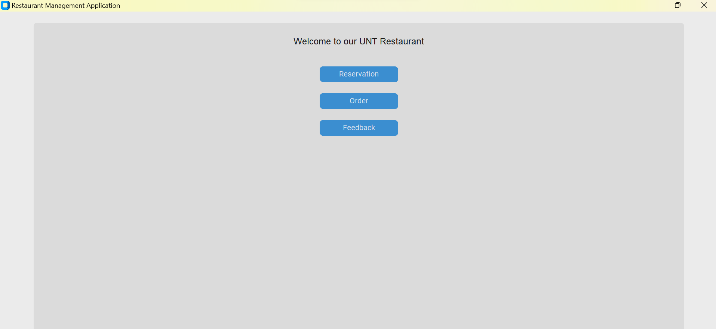
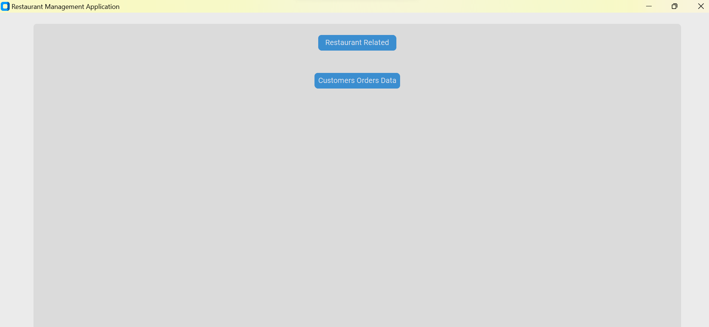
Application Main Screens (Continued)..
On Customer flow, user can avail 3 Restaurant options (Reservation, Order, Feedback) to reserve a table, order the food, and provide the feedback.
On Employee flow, user is provided with 2 options (Restaurant Related, Customer Orders Data) to view the whole data of Restaurant.

Slide 9
Demo

Slide 10

Thank You

